Slide 1

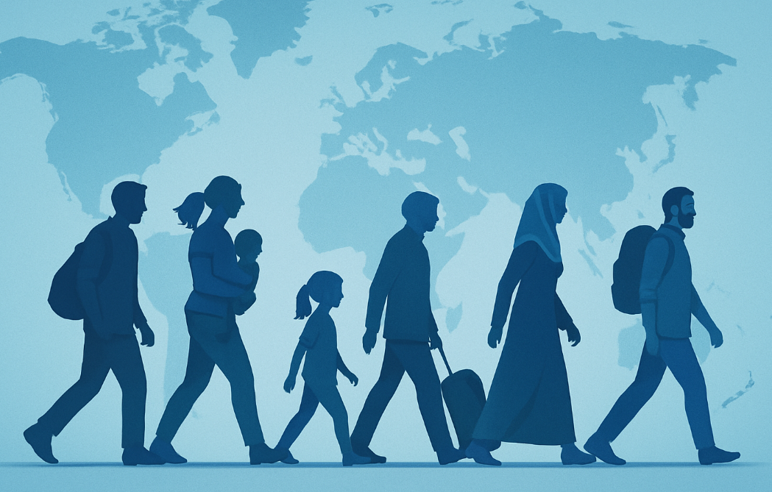


Blockchain for Migrants
FinclusionChain Team
Notes:
Please, replace the image with a more suitable. Avoid removing the blue shape!

Slide 2

Problem Statement:
Millions of migrants lack access to loans and financial services
Causes: missing credit history, incomplete ID documents, weak banking infrastructure
Blockchain tools may provide secure, verifiable, portable credit profiles

Slide 3
Research Question:
Can blockchain-based credit systems provide a viable solution to financial exclusion among migrants and refugees who lack access to traditional banking services?

Slide 4
Data Modeling Strategy:
Datasets Used:
Global Crypto Adoption Index (2022–2024) Measures grassroots use of cryptocurrency (retail, DeFi, centralized exchanges).
International Migrant Stock (2024) Measures total number of international migrants residing in each global region.
These datasets let us explore whether regions with large migrant populations are more likely to adopt decentralized financial tools.
.
Data Limitations:
Migrant data is limited to a single year
(2024).
Regions had to be manually standardized.
Crypto data reflects rankings, not usage volume.
Some regions (e.g. North America) had limited country-level representation.

Slide 5
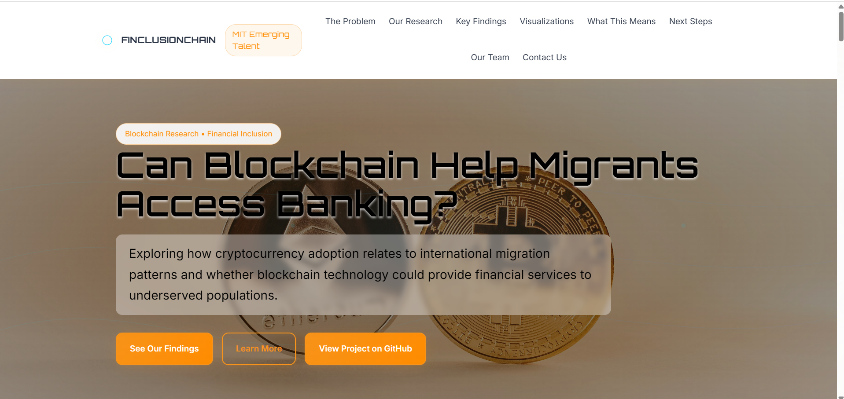

Slide 6
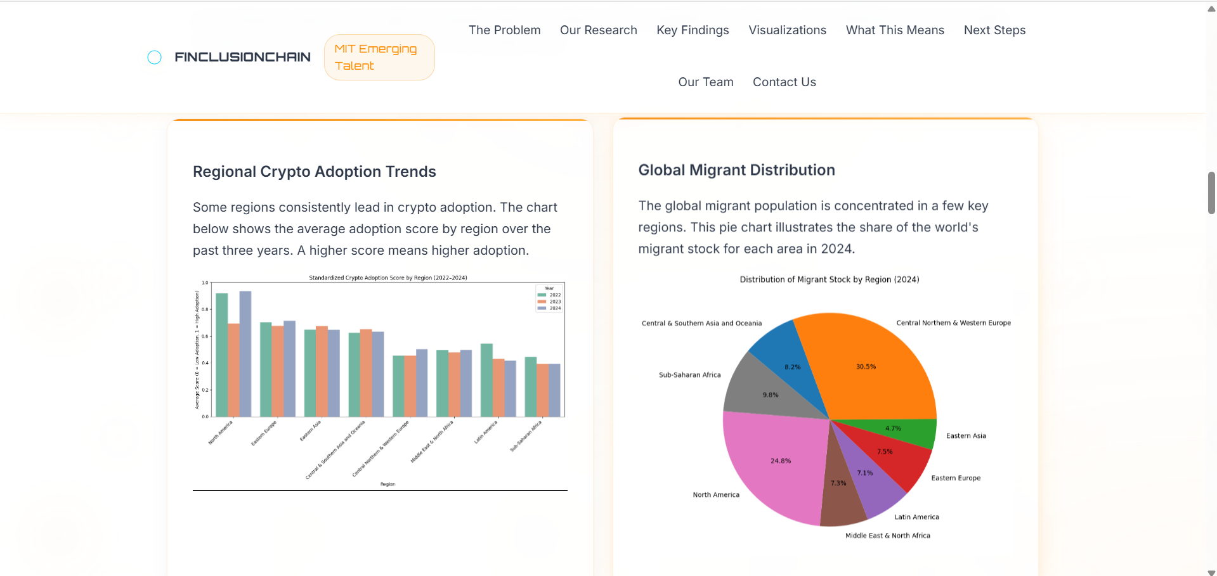

Slide 7
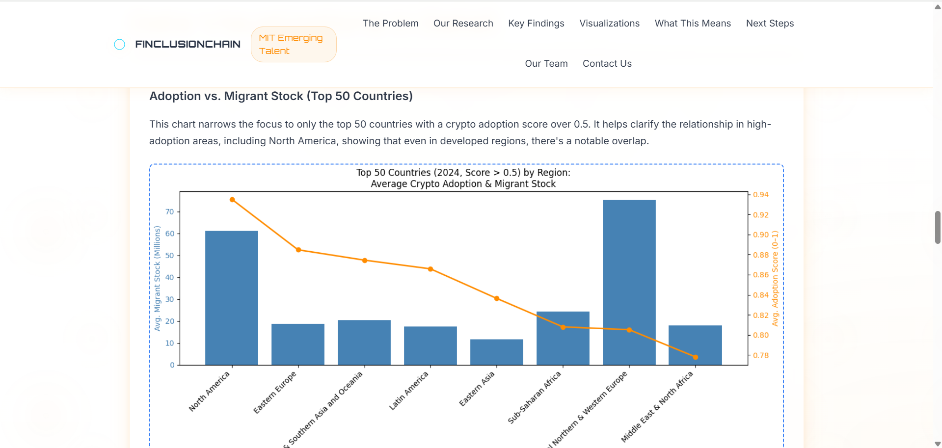

Slide 8
Findings by Countries :
High adoption countries: Vietnam, Philippines, Ukraine, India, USA
Overlaps with migrant populations:
USA – high adoption + large migrant stock
Philippines & India – strong crypto + migration flows
Ukraine – crypto growth + displaced population
Gulf States – large migrant workers, fintech adoption rising

Slide 9
Findings by Regions :
High migrant regions: North America and Central Northern & Western Europe
Regions with higher international migrant populations often show stronger engagement with cryptocurrency tools. While the correlation isn’t definitive across all regions, excluding statistical outliers like Central & Western Europe

Slide 10
Insights
Our findings suggest a moderate positive relationship between international migrant populations and cryptocurrency adoption (excluding outliers like Central & Western Europe).
Blockchain-based financial tools can be a viable alternative to traditional credit systems — especially in underserved regions. Migrants in these areas may adopt decentralized platforms that bypass the need for traditional credit histories, fostering financial inclusion.

Slide 11


Target Audience
Our outreach strategy focuses on building meaningful connections with both organizations and individual innovators who share our mission of improving financial inclusion for migrants.
Organizations:
Individuals:
ID2020
CARE
Ashutosh Bhatt
Kristy Kim
United Nations
Alliance for Financial Inclusion
Misha Esipov
Mariano Sanz

Slide 12
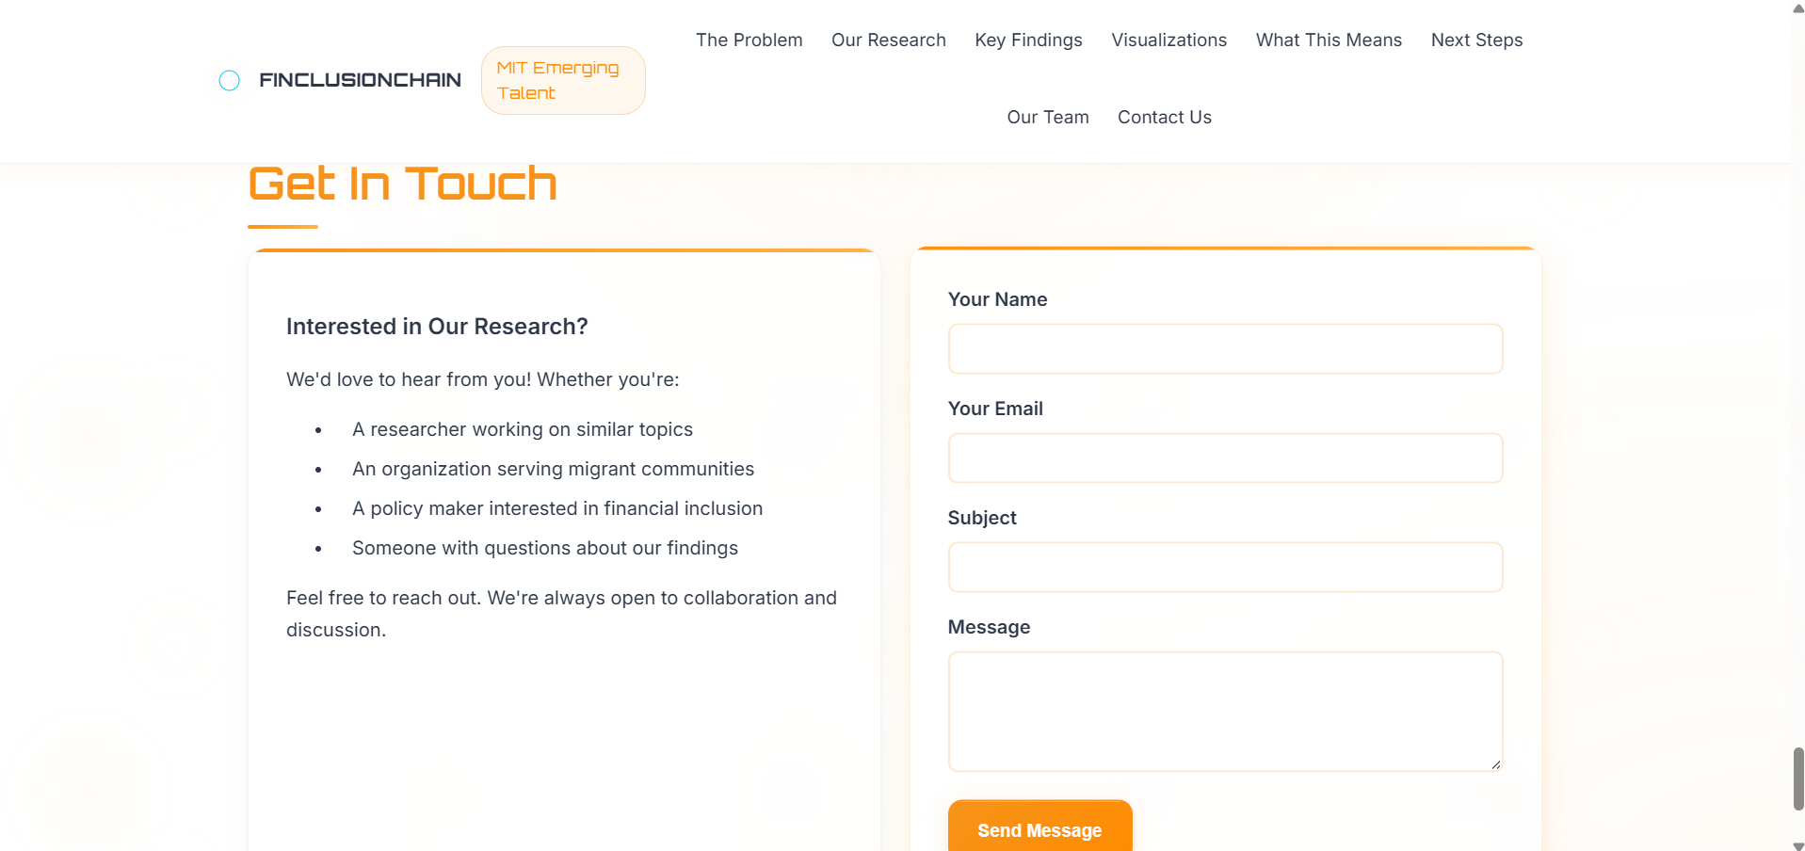

Slide 13
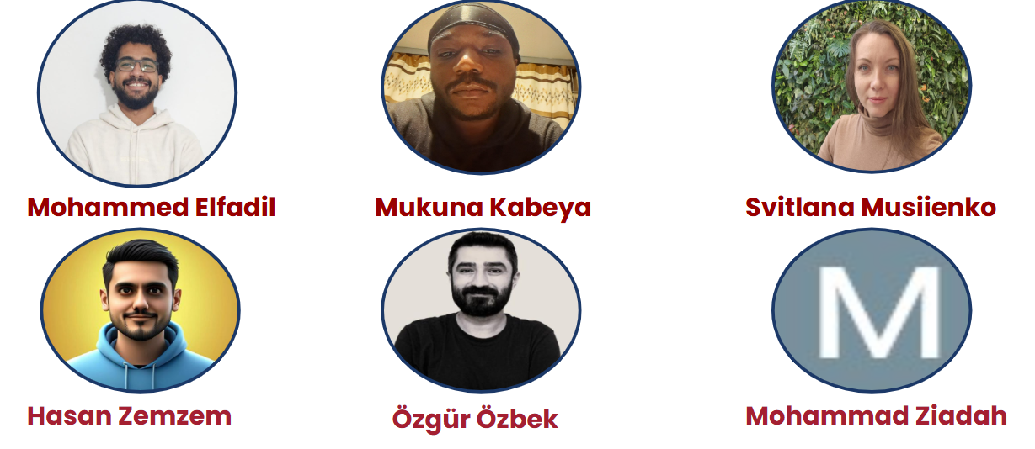
Meet the Team:

